Slide 1

Propositional Logic

Slide 2
Content
Mathematical proof (what and why)
Logic, basic operators
Using simple operators to construct any operator
Logical equivalence, DeMorgan’s law
Conditional statement (if, if and only if)
Arguments

Slide 3
Pythagorean theorem
c
b
a
Familiar?
Obvious?

Slide 4
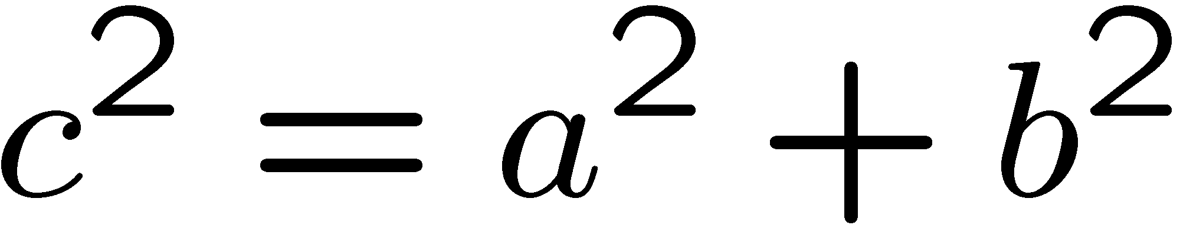
Good Proof
b
c
b-a
a
b-a
We will show that these five pieces can be rearranged into:
(i) a c×c square, and then
(ii) an a×a & a b×b square
And then we can conclude that

Slide 5
Good Proof
The five pieces can be rearranged into:
(i) a c×c square
c
b-a
c
c
a
b
c

Slide 6
Good Proof
How to rearrange them into an axa square and a bxb square?
b
c
b-a
a
b-a

Slide 7
Good Proof
a
b
b
a
b-a
a
b
74 proofs in http://www.cut-the-knot.org/pythagoras/index.shtml

Slide 8
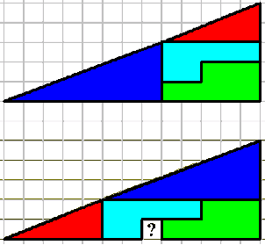
Bad Proof
A similar rearrangement technique shows that 65=64…
What’s wrong with the proof?

Slide 9
Mathematical Proof
To prove mathematical theorems, we need a more rigorous system.
The standard procedure for proving mathematical theorems is invented by
Euclid in 300BC. First he started with five axioms (the truth of these
statements are taken for granted). Then he uses logic to deduce the truth
of other statements.
It is possible to draw a straight line from any point to any other point.
It is possible to produce a finite straight line continuously in a straight line.
It is possible to describe a circle with any center and any radius.
It is true that all right angles are equal to one another.
("Parallel postulate") It is true that, if a straight line falling on two straight lines make the interior angles on the same side less than two right angles,
the two straight lines, if produced indefinitely, intersect on that side on which are the angles less than the two right angles.
Euclid’s proof of Pythagorean’s theorem
http://en.wikipedia.org/wiki/Pythagorean_theorem
(Optional) See page 18 of the notes for the ZFC axioms that we now use.

Slide 10
Content
Mathematical proof (what and why)
Logic, basic operators
Using simple operators to construct any operator
Logical equivalence, DeMorgan’s law
Conditional statement (if, if and only if)
Arguments
Now, we have seen the need of a rigorous proof system.
We will proceed to define the basic logic system.

Slide 11
Statement (Proposition)
A Statement is a sentence that is either True or False
Examples:
2 + 2 = 4
True
3 x 3 = 8
False
787009911 is a prime
Today is Tuesday.
Non-examples:
x+y>0
x²+y²=z²
They are true for some values of x and y
but are false for some other values of x and y.

Slide 12
Logic Operators
Logic operators are used to construct new statements from old statements.
There are three main logic operators, NOT, AND, OR.
¬ P is true if and only if P is false
P
¬P
T
F
F
T

Slide 13


Logic Operators
Logic operators are used to construct new statements from old statements.
There are three main logic operators, NOT, AND, OR.
P
Q
P Q
P
Q
P Q
T
T
T
T
T
T
T
F
F
T
F
T
F
T
F
F
T
T
F
F
F
F
F
F

Slide 14
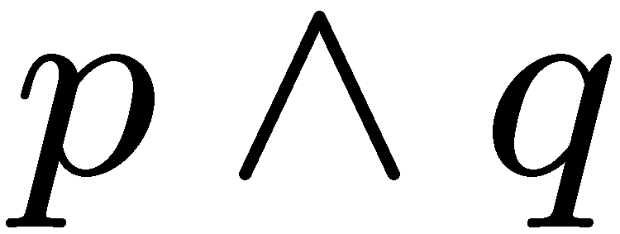
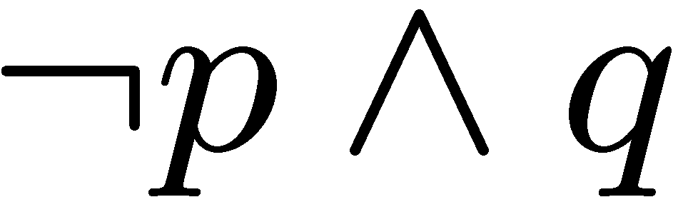
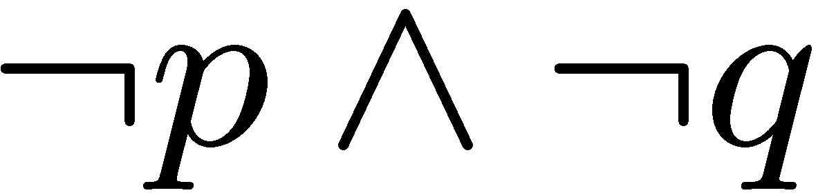
Compound Statement
p = “it is hot”
q = “it is sunny”
It is hot and sunny
It is not hot but sunny
It is neither hot nor sunny
We can also define logic operators on three or more statements, e.g. OR(P,Q,R)

Slide 15
More Logical Operators
We can define more logical operators as we need.
coffee “or” tea
majority
⊕
exclusive-or
P | Q | R | M(P,Q,R)
T | T | T | T
T | T | F | T
T | F | T | T
T | F | F | F
F | T | T | T
F | T | F | F
F | F | T | F
F | F | F | F
p | q | p  q
T | T | F
T | F | T
F | T | T
F | F | F

Slide 16
Content
Mathematical proof (what and why)
Logic, basic operators
Using simple operators to construct any operator
Logical equivalence, DeMorgan’s law
Conditional statement (if, if and only if)
Arguments
We can define as many new operators as we like.
But we will see how to construct any operator from AND, OR, NOT.

Slide 17
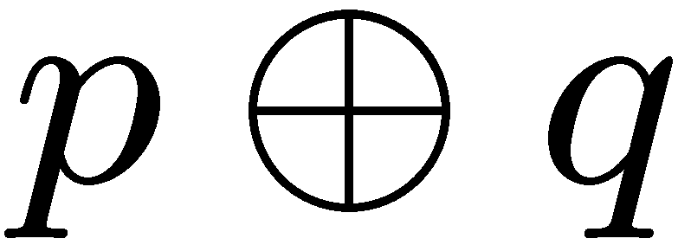
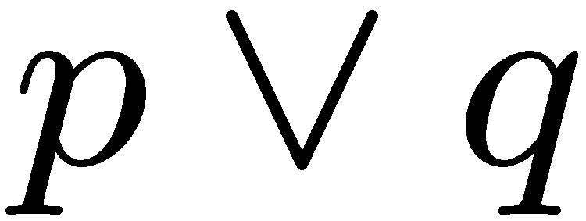
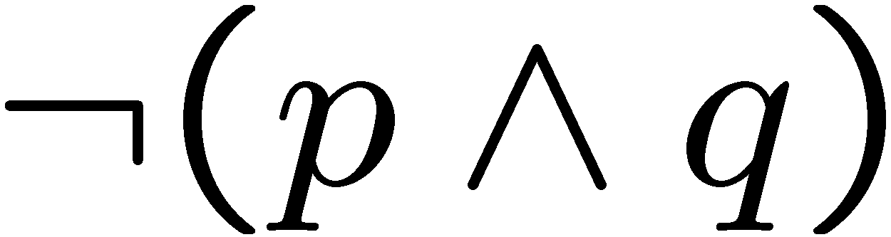
Formula for Exclusive-Or
Idea 0: Guess and check
p | q
T | T | F | T | F | F
T | F | T | T | T | T
F | T | T | T | T | T
F | F | F | F | T | F
Logical equivalence: Two statements have the same truth table
As you will see, there are many different ways to write the same logical formula.
One can always use a truth table to check whether two statements are equivalent.

Slide 18
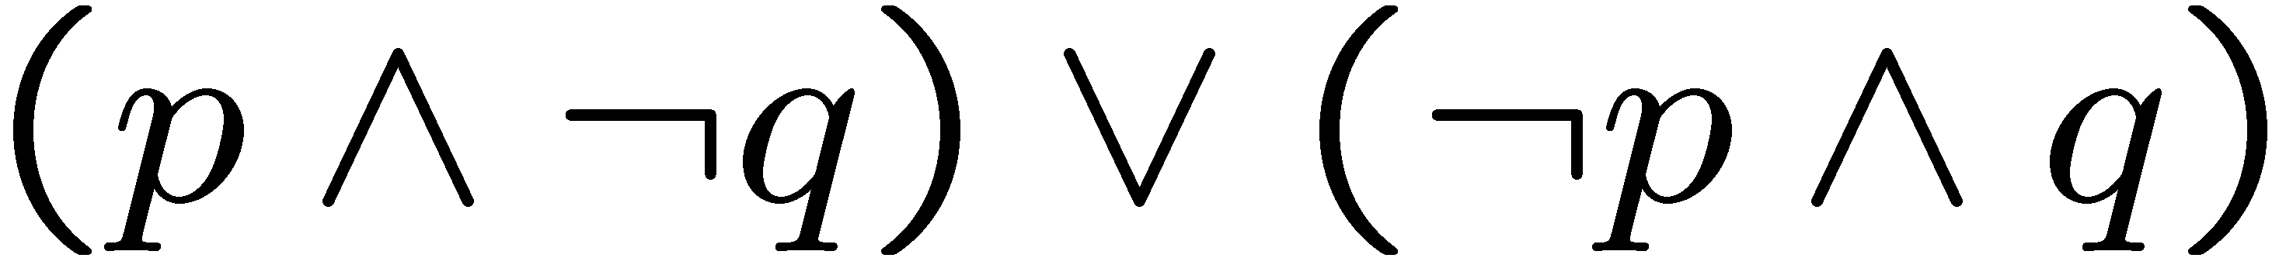
Exclusive-Or
Is there a more systematic way to construct such a formula?
Idea 1: Look at the true rows
Idea 1: Look at the true rows
Idea 1: Look at the true rows
p | q | p  q
T | T | F
T | F | T
F | T | T
F | F | F
Want the formula to be true
exactly when the input belongs
to a “true” row.
The input is the second row exactly if this sub-formula is satisfied
And the formula is true exactly when the input is the second row or the third row.

Slide 19
Exclusive-Or
Is there a more systematic way to construct such a formula?
p | q | p  q
T | T | F
T | F | T
F | T | T
F | F | F
Idea 2: Look at the false rows
Want the formula to be true
exactly when the input does
not belong to a “false” row.
The input is the first row exactly if this sub-formula is satisfied
And the formula is true exactly when the input is not in the 1st row and the 4th row.

Slide 20
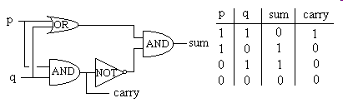
Writing Logical Formula for a Truth Table
Digital logic:
Given a digital circuit, we can construct the truth table.
Now, suppose we are given only the truth table (i.e. the specification,
e.g. the specification of the majority function), how can we construct a
digital circuit (i.e. formula) using only simple gates (such as AND, OR, NOT)
that has the same function?

Slide 21
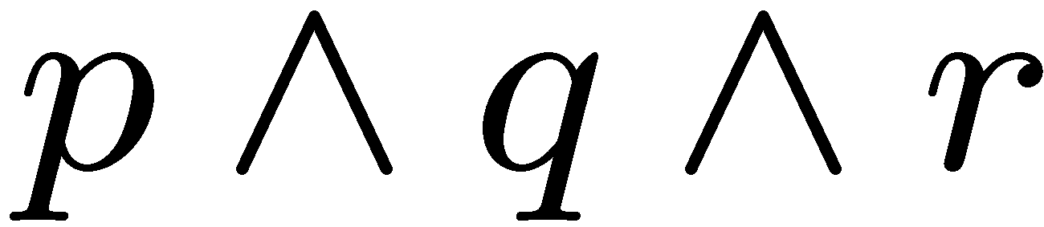
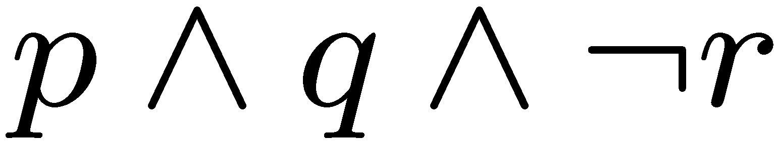
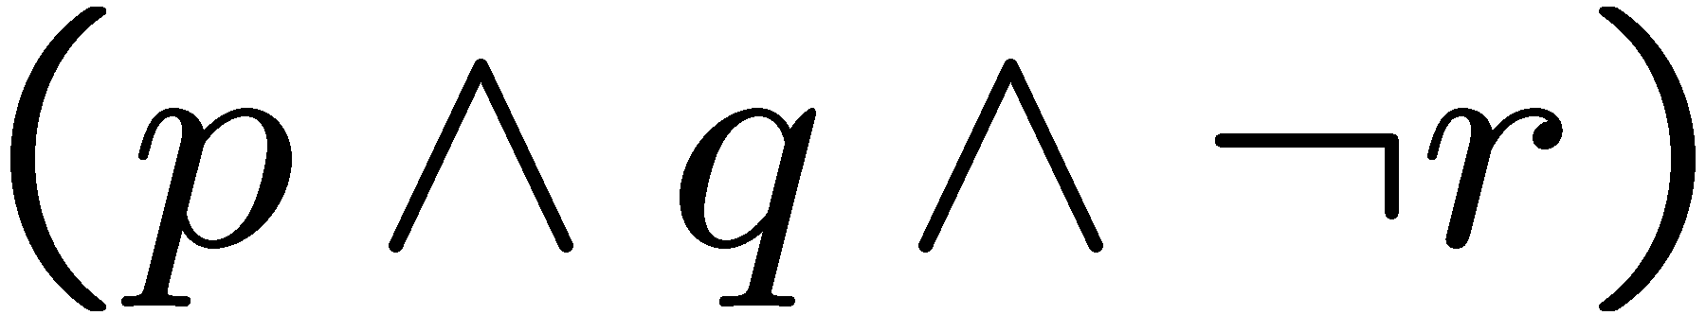
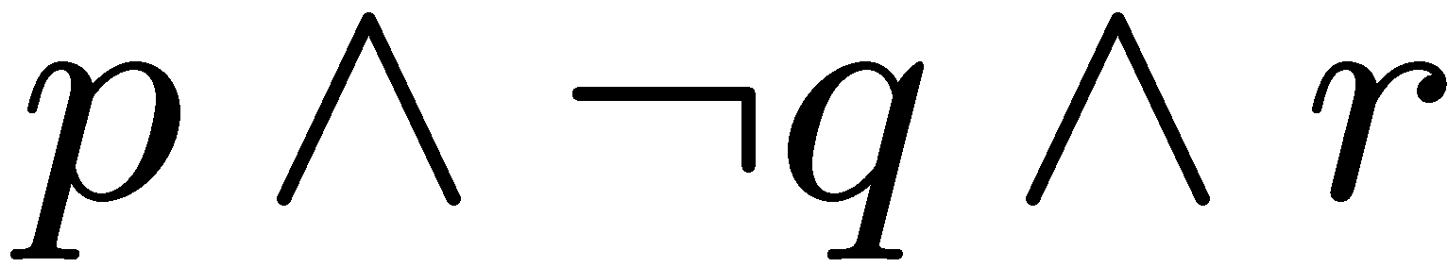
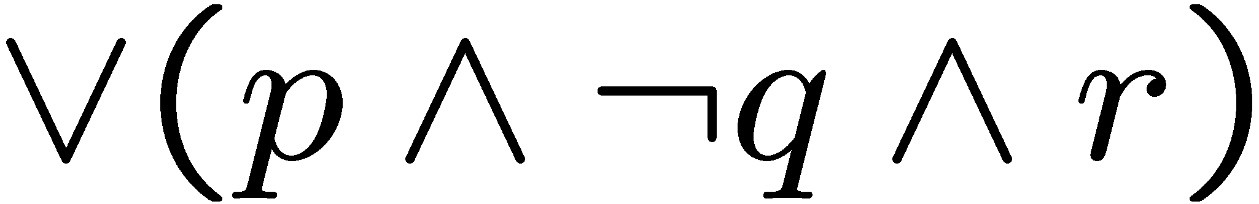
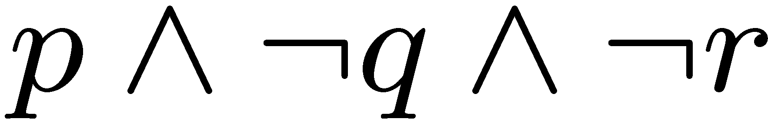
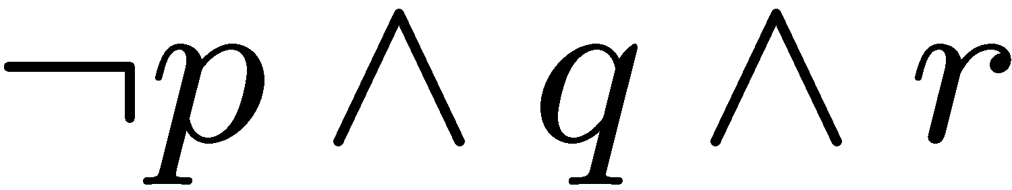
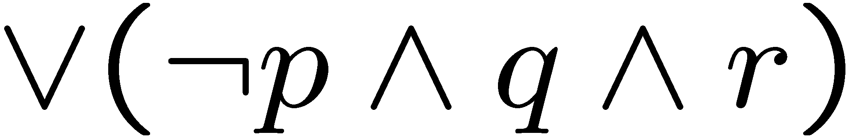
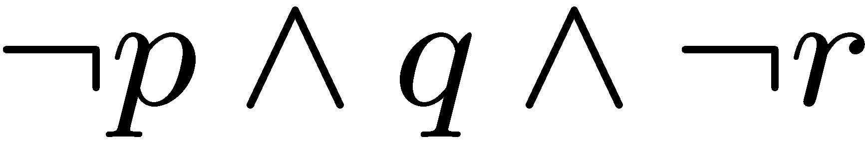
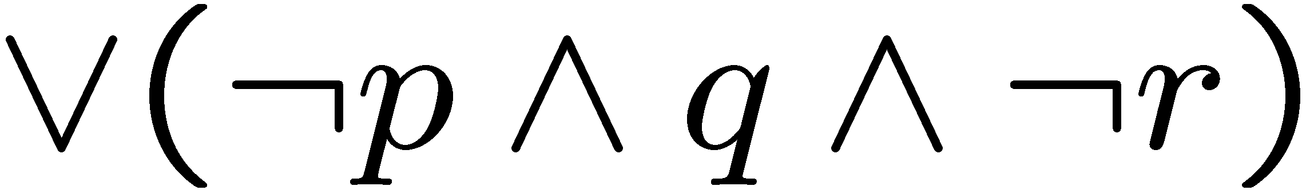
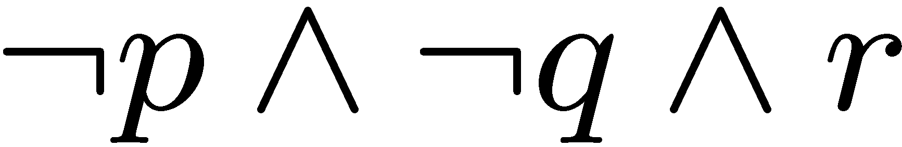
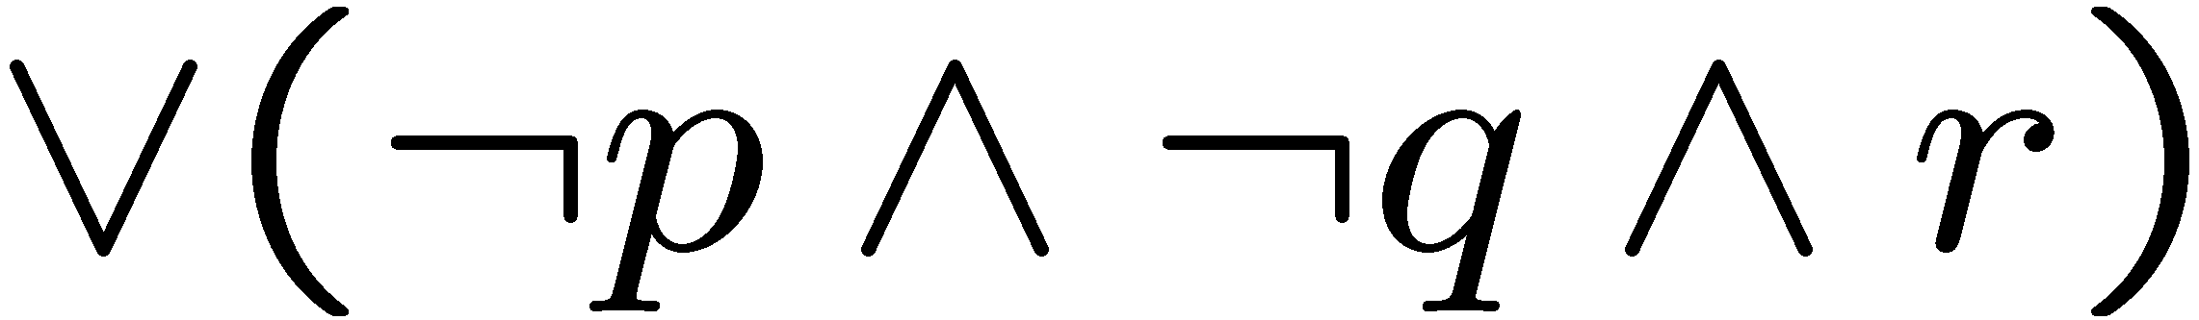
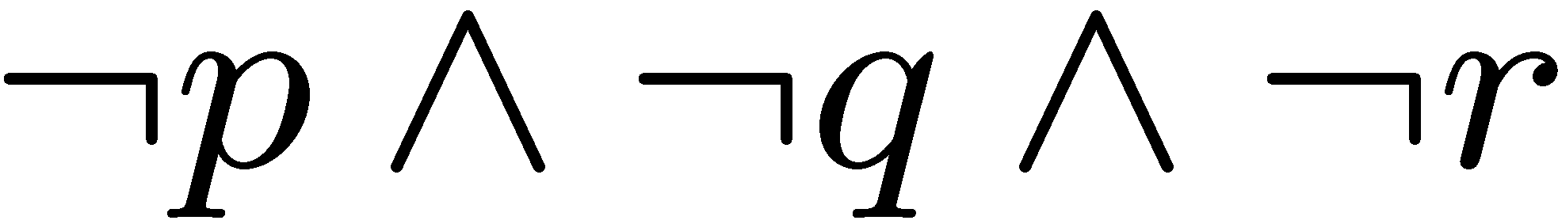
Writing Logical Formula for a Truth Table
Use idea 1 or idea 2.
Idea 1: Look at the true rows
and take the “or”.
p | q | r | output
T | T | T | F
T | T | F | T
T | F | T | T
T | F | F | F
F | T | T | T
F | T | F | T
F | F | T | T
F | F | F | F
The formula is true exactly when the input is one of the true rows.

Slide 22
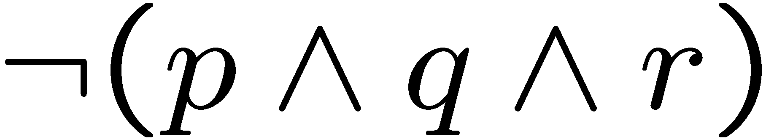
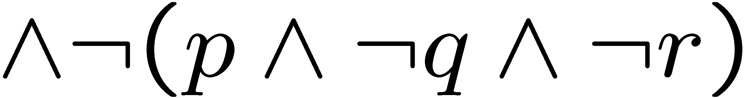
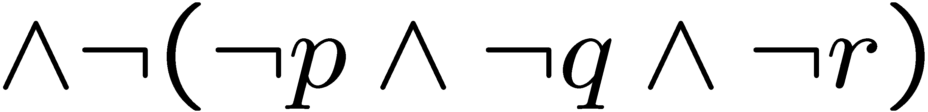
Writing Logical Formula for a Truth Table
Idea 2: Look at the false rows,
negate and take the “and”.
p | q | r | output
T | T | T | F
T | T | F | T
T | F | T | T
T | F | F | F
F | T | T | T
F | T | F | T
F | F | T | T
F | F | F | F
The formula is true exactly when the input is not one of the false row.

Slide 23
Content
Mathematical proof (what and why)
Logic, basic operators
Using simple operators to construct any operator
Logical equivalence, DeMorgan’s law
Conditional statement (if, if and only if)
Arguments
There are many different ways to write the same logical formula.
As we have seen, one can always write a formula using only AND, OR, NOT.

Slide 24

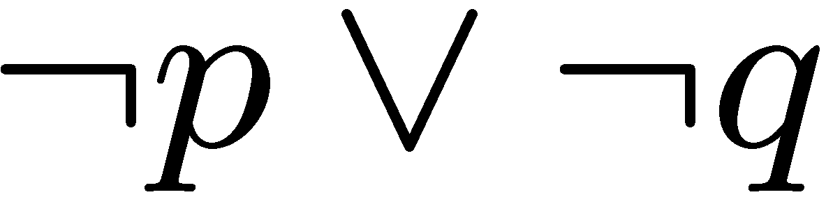
DeMorgan’s Laws
Logical equivalence: Two statements have the same truth table
Statement: Tom is in the football team and the basketball team.
Negation: Tom is not in the football team or not in the basketball team.
De Morgan’s Law
Why the negation of the above statement is not the following
“Tom is not in the football team and not in the basketball team”?
The definition of the negation is that exactly one of P or ¬P is true, but it
could be the case that both the above statement and the original statement
are false (e.g. Tom is in the football team but not in the basketball team).

Slide 25

DeMorgan’s Laws
Logical equivalence: Two statements have the same truth table
Statement: The number 783477841 is divisible by 7 or 11.
Negation: The number 783477841 is not divisible by 7 and not divisible by 11.
De Morgan’s Law
Again, the negation of the above statement is not
“The number 783477841 is not divisible by 7 or not divisible by 11”.
In either case, we “flip” the inside operator from OR to AND or from AND to OR.

Slide 26


DeMorgan’s Laws
Logical equivalence: Two statements have the same truth table
De Morgan’s Law
T | T | F | F
T | F | T | T
F | T | T | T
F | F | T | T
De Morgan’s Law

Slide 27
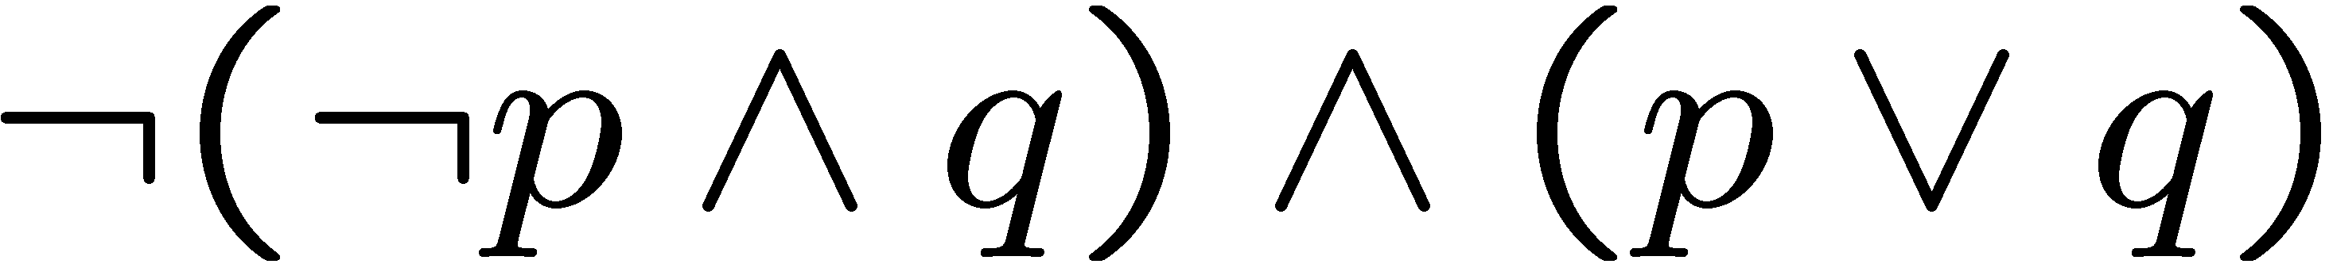
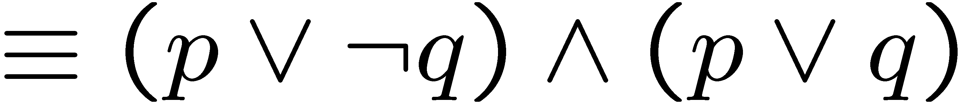
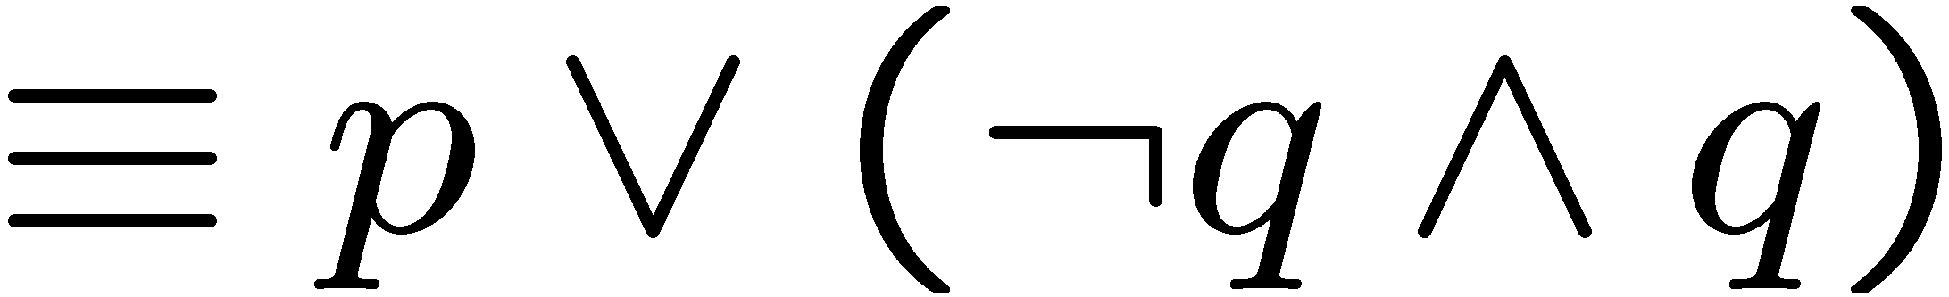


Simplifying Statement
We can use logical rules to simplify a logical formula.
DeMorgan
Distributive law
The DeMorgan’s Law allows us to always “move the NOT inside”.
(Optional) See textbook for more identities.

Slide 28
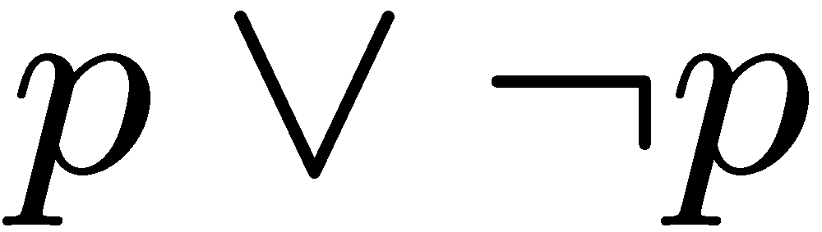
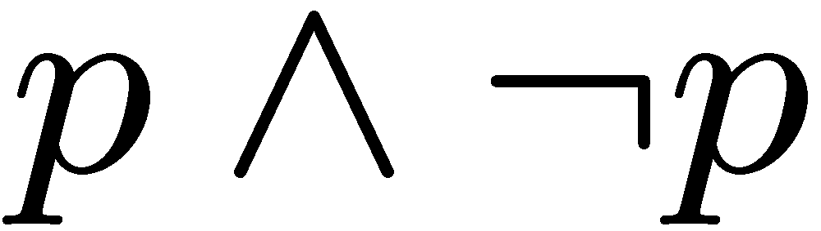
Tautology, Contradiction
A tautology is a statement that is always true.
A contradiction is a statement that is always false.
(negation of a tautology)
In general it is “difficult” to tell whether a statement is a contradiction.
It is one of the most important problems in CS – the satisfiability problem.

Slide 29
Checkpoint
Key points to know.
Write a logical formula from a truth table.
Check logical equivalence of two logical formulas.
DeMorgan’s rule and other simple logical rules (e.g. distributive).
Use simple logical rules to simplify a logical formula.

Slide 30
Content
Mathematical proof (what and why)
Logic, basic operators
Using simple operators to construct any operator
Logical equivalence, DeMorgan’s law
Conditional statement (if, if and only if)
Arguments

Slide 31

Conditional Statement
If p then q
p implies q
p is called the hypothesis; q is called the conclusion
The department says:
“If your GPA is 4.0, then you will have full scholarship.”
When is the above sentence false?
It is false when your GPA is 4.0 but you don’t receive full scholarship.
But it is not false if your GPA is below 4.0.
Another example: “If there is typhoon T8 today, then there is no class.”
When is the above sentence false?

Slide 32

Logic Operator
P
Q
P Q
T
T
T
T
F
F
F
T
T
F
F
T
Convention: if we don’t say anything wrong, then it is not false, and thus true.
Make sure you understand the definition of IF.
The IF operation is very important in mathematical proofs.

Slide 33
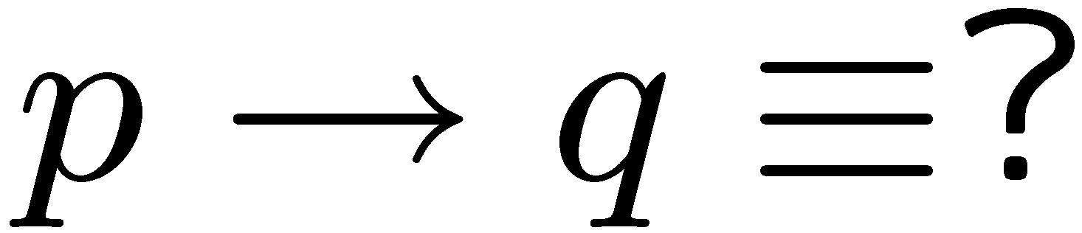
Logical Equivalence
If you see a question in the above form,
there are usually 3 ways to deal with it.
Truth table
Use logical rules
Intuition

Slide 34
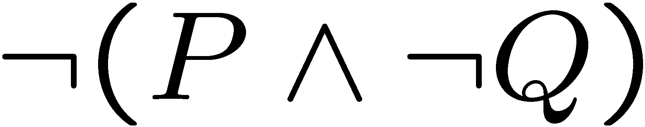

If-Then as Or
P
Q
P Q
Idea 2: Look at the false rows,
negate and take the “and”.
T
T
T
T
F
F
F
T
T
F
F
T
If you don’t give me all your money, then I will kill you.
Either you give me all your money or I will kill you (or both).
If you talk to her, then you can never talk to me.
Either you don’t talk to her or you can never talk to me (or both).

Slide 35
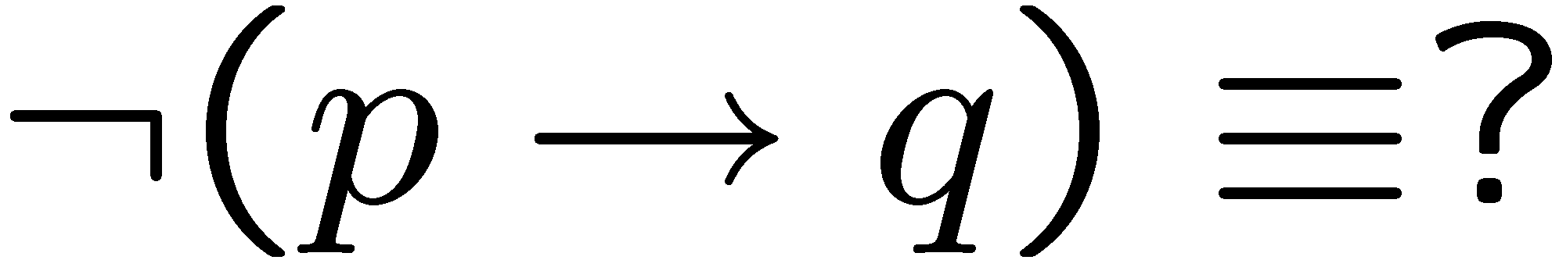
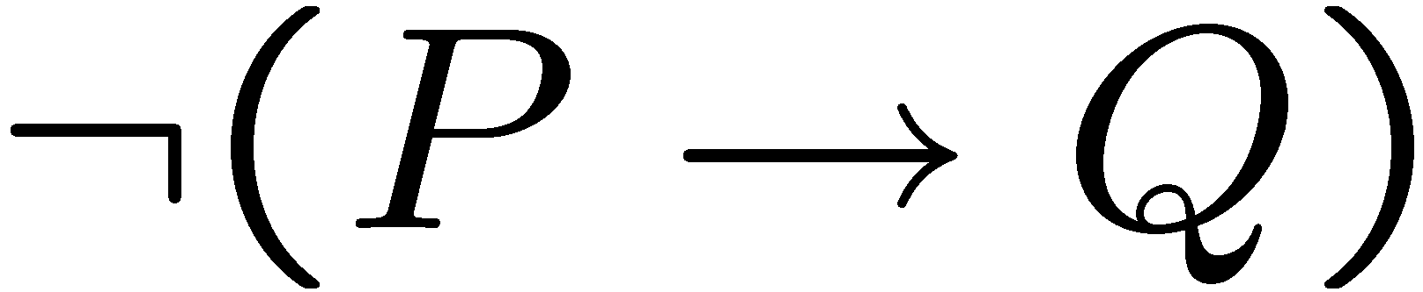



Negation of If-Then
If you eat an apple everyday, then you have no toothache.
You eat an apple everyday but you have toothache.
If my computer is not working, then I cannot finish my homework.
My computer is not working but I can finish my homework.
previous slide
DeMorgan

Slide 36
Contrapositive
The contrapositive of “if p then q” is “if ~q then ~p”.
Statement: If you are a CS year 1 student,
then you are taking CSC 2110.
Contrapositive: If you are not taking CSC 2110,
then you are not a CS year 1 student.
Statement: If you drive, then you don’t drink.
Contrapositive: If you drink, then you don’t drive.
Fact: A conditional statement is logically equivalent to its contrapositive.

Slide 37




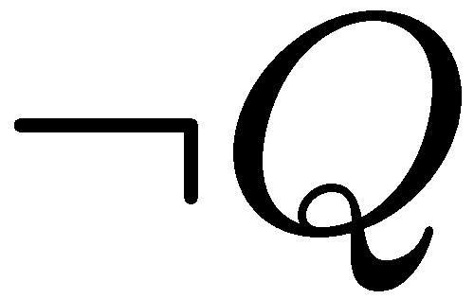

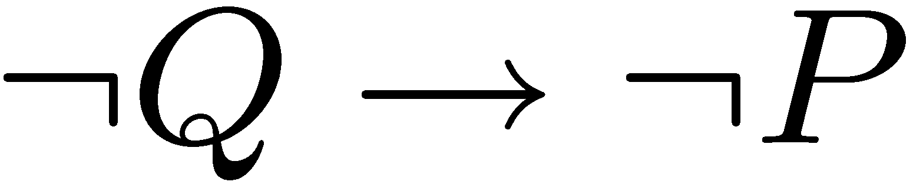
Proofs
Statement: If P, then Q
Contrapositive: If Q, then P.
T | T | T
T | F | F
F | T | T
F | F | T
F | F | T
T | F | F
F | T | T
T | T | T
In words, the only way the above statements are false is when P true and Q false.

Slide 38



Contrapositive
Statement: If P, then Q
Contrapositive: If Q, then P.
Or we can see it using logical rules:
Contrapositive is useful in mathematical proofs, e.g. to prove
Statement: If x² is an even number, then x is an even number.
You could instead prove:
Contrapositive: If x is an odd number, then x² is an odd number.
This is equivalent and is easier to prove.

Slide 39
If, Only-If
You succeed if you work hand.
You succeed only if you work hard.
R if S means “if S then R” or equivalently “S implies R”
We also say S is a sufficient condition for R.
R only if S means “if R then S” or equivalently “R implies S”
We also say S is a necessary condition for R.
You will succeed if and only if you work hard.
P if and only if (iff) Q means P and Q are logically equivalent.
That is, P implies Q and Q implies P.

Slide 40
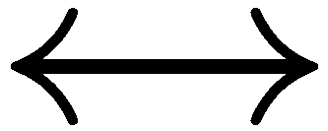
Necessary AND Sufficient Condition
P
Q
P Q
T
T
T
T
F
F
F
T
F
F
F
T
Note: P Q is equivalent to (P Q) (Q P)
Note: P Q is equivalent to (P Q) ( P Q)
Is the statement “x is an even number if and only if x² is an even number” true?

Slide 41





Math vs English
Parent: if you don’t clean your room, then you can’t watch a DVD.
C
D
This sentence says
So
In real life it also means
Mathematician: if a number x greater than 2 is not an odd number,
then x is not a prime number.
This sentence says
But of course it doesn’t mean

Slide 42
Necessary, Sufficient Condition
Mathematician: if a number x greater than 2 is not an odd number,
then x is not a prime number.
This sentence says
But of course it doesn’t mean
Being an odd number > 2 is a necessary condition for this number to be prime.
Being a prime number > 2 is a sufficient condition for this number to be odd.

Slide 43
Checkpoint
Conditional Statements
The meaning of IF and its logical forms
Contrapositive
If, only if, if and only if

Slide 44
Content
Mathematical proof (what and why)
Logic, basic operators
Using simple operators to construct any operator
Logical equivalence, DeMorgan’s law
Conditional statement (if, if and only if)
Arguments

Slide 45

Argument
An argument is a sequence of statements.
All statements but the final one are called assumptions or hypothesis.
The final statement is called the conclusion.
An argument is valid if:
whenever all the assumptions are true, then the conclusion is true.
If today is Wednesday, then yesterday is Tuesday.
Today is Wednesday.
Yesterday is Tuesday.
Informally, an argument is valid if the conclusion follows from the assumptions.

Slide 46
Argument
An argument is a sequence of statements.
All statements but the final one are called assumptions or hypothesis.
The final statement is called the conclusion.
An argument is valid if:
whenever all the assumptions are true, then the conclusion is true.
It is possible to draw a straight line from any point to any other point.
It is possible to produce a finite straight line continuously in a straight line.
It is possible to describe a circle with any center and any radius.
It is true that all right angles are equal to one another.
("Parallel postulate") It is true that, if a straight line falling on two straight lines make the interior angles on the same side less than two right angles,
the two straight lines, if produced indefinitely, intersect on that side on which are the angles less than the two right angles.
Pythagorean’s theorem
This is the formal way to prove theorems from axioms.

Slide 47
Modus Ponens
Rule:
If p then q.
p
q
If typhoon, then class cancelled.
Typhoon.
Class cancelled.
assumptions
conclusion
p | q | p→q | p | q
T | T | T | T | T
T | F | F | T | F
F | T | T | F | T
F | F | T | F | F
Modus ponens is Latin meaning “method of affirming”.

Slide 48
Modus Tollens
Rule:
If p then q.
~q
~p
If typhoon, then class cancelled.
Class not cancelled.
No typhoon.
assumptions
conclusion
p | q | p→q | ~q | ~p
T | T | T | F | F
T | F | F | T | F
F | T | T | F | T
F | F | T | T | T
Modus tollens is Latin meaning “method of denying”.

Slide 49
Equivalence
A student is trying to prove that propositions P, Q, and R are all true.
She proceeds as follows.
First, she proves three facts:
P implies Q
Q implies R
R implies P.
Then she concludes,
``Thus P, Q, and R are all true.''
Proposed argument:
assumption
Is it valid?
conclusion

Slide 50




Valid Argument?
Is it valid?
assumptions
conclusion
P | Q | R
T | T | T
T | T | F
T | F | T
T | F | F
F | T | T
F | T | F
F | F | T
F | F | F
T | T | T
T | F | T
F | T | T
F | T | T
T | T | F
T | F | T
T | T | F
T | T | T
 | OK?
T | yes
F | yes
F | yes
F | yes
F | yes
F | yes
F | yes
F | no
To prove an argument is not valid, we just need to find a counterexample.

Slide 51
Valid Arguments?
assumptions
conclusion
p | q | p→q | q | p
T | T | T | T | T
T | F | F | F | T
F | T | T | T | F
F | F | T | F | F
If p then q.
q
p
Assumptions are true, but not the conclusion.
If you are a fish, then you drink water.
You drink water.
You are a fish.

Slide 52
Valid Arguments?
assumptions
conclusion
p | q | p→q | ~p | ~q
T | T | T | F | F
T | F | F | F | T
F | T | T | T | F
F | F | T | T | T
If p then q.
~p
~q
If you are a fish, then you drink water.
You are not a fish.
You do not drink water.

Slide 53
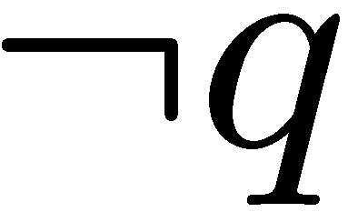
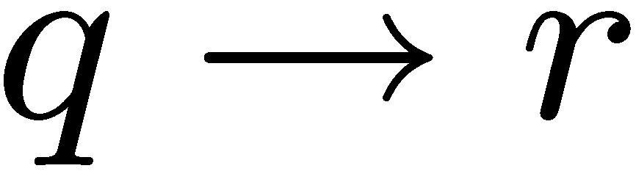

Exercises

Slide 54

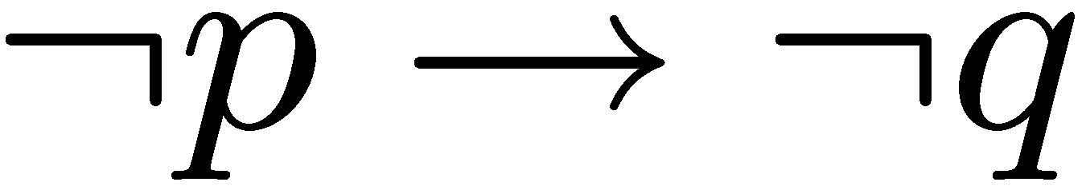

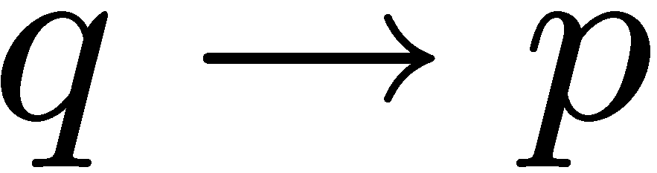
More Exercises
Valid argument True conclusion
True conclusion Valid argument

Slide 55

Contradiction
If you can show that the assumption that the statement
p is false leads logically to a contradiction,
then you can conclude that p is true.
This is similar to the method of denying (modus tollens)

Slide 56
Truth-tellers and Liers
Truth-tellers always tell the truth.
Liers always lie.
A says: B is a truth-teller.
B says: A and I are of opposite type.
Suppose A is a truth-teller.
Then B is a truth-teller (because what A says is true).
Then A is a lier (because what B says is true)
A contradiction.
So A must be a lier.
So B must be a lier (because what A says is false).
No contradiction.

Slide 57
Quick Summary
Arguments
definition of a valid argument
method of affirming, denying, contradiction
Key points:
Make sure you understand conditional statements and contrapositive.
Make sure you can check whether an argument is valid.

Slide 58
Which is true?
Which is false?
“The sentence below is false.”
“The sentence above is true.”

